Slide 1




MAC SMS Opt-in
Carrier Submittal Package

Slide 2
Carrier checklist:
Proof of Opt In: Screenshots of customer preference portal, advertisement, Script, etc.
Mobile T&C’s
Help Email
Toll Free Number
2 Short Code Receipts (MessageBroadcast will provide to carriers when short code is purchased)

Slide 3
List of requirements when opting in:
Color contrast must be great enough
Shortcode/Keyword opt in: All information should be listed close to where keyword or shortcode is listed
Web Ingest: Click on verify
Disclosure: (Sample Disclosure is listed below)
Program sponsor
Service Description
Frequency of messaging (Ex: 1 msg/query, Msg Frequ Varies)
Help instructions: Text HELP for Help (HELP must be bold)
Opt out Info: To stop text STOP to <SC #> (STOP must be bold)
Additional carrier costs: ‘ Msg&Data Rates May Apply’
Static Terms and Conditions: Mobile T&Cs available at www.xyz.com/sss
Participating carriers: ACG, ALLTEL AWCC, AT&T Mobility, Boost, Cincinnati Bell, Cricket, Google Voice, Metro PCS, Rural Carrier Groups, Sprint, Tier 2/3 Carrier Group, T-Mobile, U.S. Cellular, Verizon Wireless, Virgin Mobile
Double Opt-In: MessageBroadcast recommends informing the customer that they will receive a text shortly after registering their account for SMS alerts. Let them know that they must respond ‘Yes’ to complete the registration process. This will help increase the opt-in completion rate.
Additional Note: A submit button will need to be included.
Sample Disclosure: MAC Alerts and Notifications: Message frequency depends on user. Text STOP to XXXXX or XXXXXX to cancel. Text HELP to XXXXX or XXXXX for assistance or email to demoHELP@mobileauthcorp.com. Message and data rates may apply. Participating carriers are: ACG, ALLTEL AWCC, AT&T Mobility, Boost, Cincinnati Bell, Cricket, Google Voice, Metro PCS, Rural Carrier Groups, Sprint, Tier 2/3 Carrier Group, T-Mobile, U.S. Cellular, Verizon Wireless, Virgin Mobile
Mobile Terms and Conditions www.mobileauthcorp.com – Need a live link
Privacy Policy www.mobileauthcorp.com – Need a live link

Slide 4
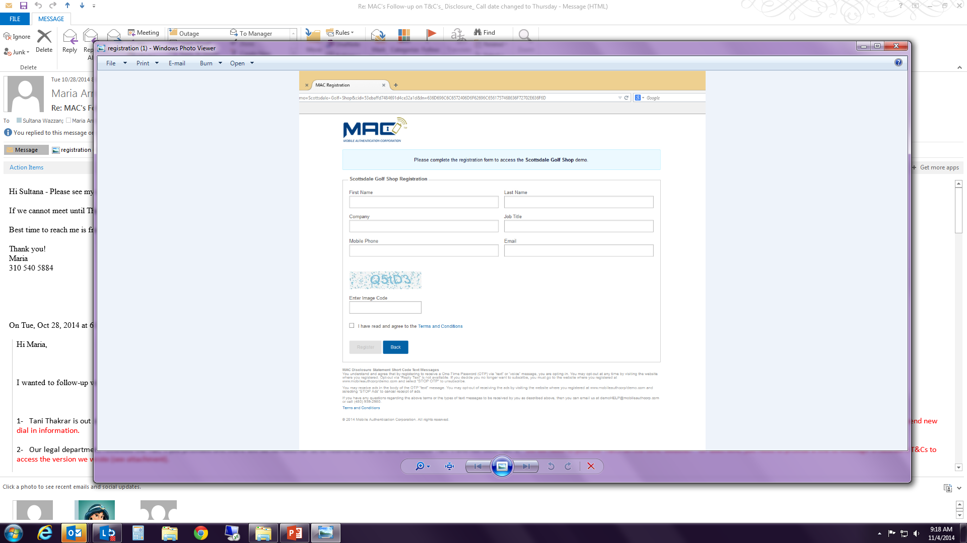
Sample screenshots:
MAC Alerts and Notifications: Message frequency depends on user. Text STOP to XXXXX or XXXXXX to cancel. Text HELP to XXXXX or XXXXX for assistance or email to demoHELP@mobileauthcorp.com. Message and data rates may apply. Participating carriers are: ACG, ALLTEL AWCC, AT&T Mobility, Boost, Cincinnati Bell, Cricket, Google Voice, Metro PCS, Rural Carrier Groups, Sprint, Tier 2/3 Carrier Group, T-Mobile, U.S. Cellular, Verizon Wireless, Virgin Mobile
Mobile Terms and Conditions www.mobileauthcorp.com – Need a live T&C link I Privacy Policy www.mobileauthcorp.com – Need a live PP link

Slide 5
Sample Mobile T&C’s:
www.mobileauthcorp.com – Need a live T&C link
Mobile authentication corp mobile terms and Conditions
for Text Messages Providing Alerts and/or Notices
You have subscribed and expressly consented to receive SMS alerts and notifications on your mobile telecommunications device from Mobile Authentication Corp ('us' or 'we' or 'our') for purposes of providing you notices and/or alerts regarding your account with us. You acknowledge, understand and agree as follows:
Message frequency depends on user. Message and Data rates may apply. These would be charged by, and be payable by you to, your mobile service provider. You acknowledge, understand and agree that we shall not be held liable for any delays in the receipt of our text message to you, as its delivery is subject to effective transmission from your mobile service provider. In addition, if you decide you no longer want to subscribe, you can respond to any text alert and notifications you receive by texting in the word STOP to (XXXXX) or (XXXXX) to cancel.
Messages sent via SMS may not be delivered to you if your phone is not in range of a transmission site, or if sufficient network capacity is not available at a particular time. Even within a coverage area, factors beyond the control of your wireless carrier may interfere with message delivery, including the customer's equipment, terrain, proximity to buildings, foliage, and weather. You acknowledge that urgent alerts may not be timely received and that your wireless carrier does not guarantee that alerts will be delivered.
Content may not be available on all carriers. Participating carriers are: ACG, ALLTEL AWCC, AT&T Mobility, Boost, Cincinnati Bell, Cricket, Google Voice, Metro PCS, Rural Carrier Groups, Sprint, Tier 2/3 Carrier Group, T-Mobile, U.S. Cellular, Verizon Wireless, Virgin Mobile. Data obtained by us from you in connection with our providing you the text messages as described above may include your cellular number, the name of your mobile service provider, and the date, time and content of the text messages we send you. We may use this information to contact you and to provide the text messages you have requested.
If you have any questions regarding the above terms or the types of text messages to be received by you as described above, then you can respond to any such message you receive by texting in the word HELP and replying back to the message at (XXXXX) or (XXXXX). Or, you can contact us at XXX-XXX-XXXX or by visiting www.mobileauthcorp.com.
Privacy Policy www.mobileauthcorp.com – Need a live PP link

Slide 6
Sample Session flows – Opt IN
TYPE OF MESSAGE | SUBSCRIPTION ALET TEXT MESSAGES
One-Time Double-Opt-In Message 151 characters | MAC Alert: You’ve chosen to receive alerts. Reply YES to confirm, HELP for help or STOP to cancel. Msg freq depends on user. Msg&Data rates may apply.
Customer Response Up to 3 characters | Yes
Double-Opt-In Confirmation 137 characters | MAC Alert: Registration is complete. Reply HELP for help or STOP to cancel. Msg freq depends on user. Msg&Data rates may apply.
STOP Message 113 characters | MAC Alert: You have opted out. You will not receive additional messages. Call us at XXX-XXX-XXXX for assistance.
HELP Message 136 characters | MAC Alert: Msg&Data rates may apply. Msg freq depends on user. Call us at XXX-XXX-XXXX for assistance. Reply STOP to cancel all alerts.
Invalid Message 91 characters | MAC Alert: You have sent an invalid response. Please call us at XXX-XXX-XXXX for assistance.
Alert MT TBD Characters | MAC Alert: (Merchant or Financial Institution Name), TCode:(XXXXXX), Merchant Link Example: Scottsdale Golf Store,Tcode:244990, http://golf.mobileauthcorp.net

